Slide 1
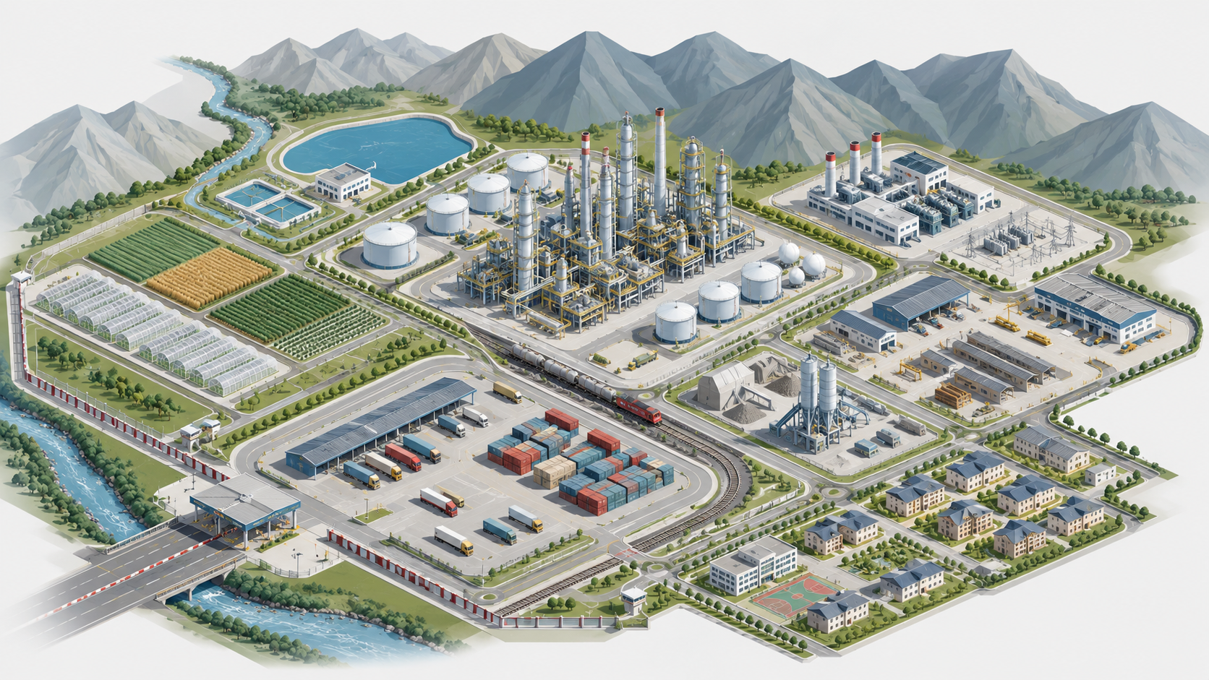
FEZ “MAIMAK”
PROPOSED DEVELOPMENT
MODEL
From a refinery project site to a managed industrial and logistics corridor
The refinery remains the strategic core. Early contours — water, services, logistics and local production — lower the investment threshold and prepare the site for scale-up.
Materials for a briefing meeting with the President of the Kyrgyz Republic
Conceptual illustration. Not an approved master plan.

Slide 2
01
Proposed Development Logic for FEZ “Maimak”
The refinery remains the strategic core, while early contours prepare the territory for industrial scale-up
What is proposed
New formula
Core implementation principles
Refinery — the core
Early contours — not a substitute,
but preparation of the territory
Each new stage — only after demand, resources and financing are confirmed
present the FEZ as an industrial and logistics platform, not as a single facility
separate the parallel preparation of the refinery from early territorial development
establish that scale-up is allowed only after resources, demand and financing are verified
formulate a clear request to the state: coordination, permits and infrastructure support
establish the refinery as the clear strategic core of the project
develop a functional territorial scheme followed by a professional master plan
prepare a roadmap and readiness-confirmation criteria
separate roles through project companies and partners
managed FEZ development model

Slide 3
02
The project is based on an established legal, land and infrastructure foundation
This is not a greenfield idea, but the relaunch and development of a project with an existing documentary and asset base
1998
40 ha → up to 500 ha
3.5 mtpa
≈ 5.1 years
Start of JSC “TIC “Temirlan-Oil” activities within the FEZ “Maimak” project
long-term land contour with expansion potential
design crude throughput of the refinery
indicative payback period based on project calculations
Already documented in the project materials
What creates the practical basis for the next step
corporate and land documents, including the state act and lease agreement
survey permits, architectural planning documents and technical conditions
seismic, climate and geological conclusions for the site
letters of support and project approval from Kyrgyz Republic authorities
work on connection to oil pipeline infrastructure and crude supply
refinery construction roadmap and work with designers
existing site elements: railway embankment, administrative building, foundations, water supply
interest from technical, financial and industrial partners

Slide 4
03
Target model: the FEZ as a system of interconnected functions
The proposal is to develop a managed industrial and logistics platform, not a set of isolated facilities
Water and land
Engineering platform
primary resource, territorial control, agro and construction launch
power, water, wastewater, fire safety, communications
Refinery
strategic
core
Logistics
Residents and production
rail, roads, storage, transshipment, future pipeline
precast concrete, steel structures, repairs, packaging, fertilizers, plastics
Model principle: early contours create demand, competencies and infrastructure value; the refinery transforms the site into a regional-scale industrial hub.

Slide 5
04
Conceptual Functional Zoning
The scheme shows the proposed functional logic for territorial development
Refinery and
storage tanks
energy
module
water
contour
agro and
greenhouse block
base
production
school and
kindergartens
rail and logistics
workforce and
social block
The next project step is to develop a master plan with engineering placement of facilities, networks, sanitary zones and transport flows.
Conceptual visualization.

Slide 6
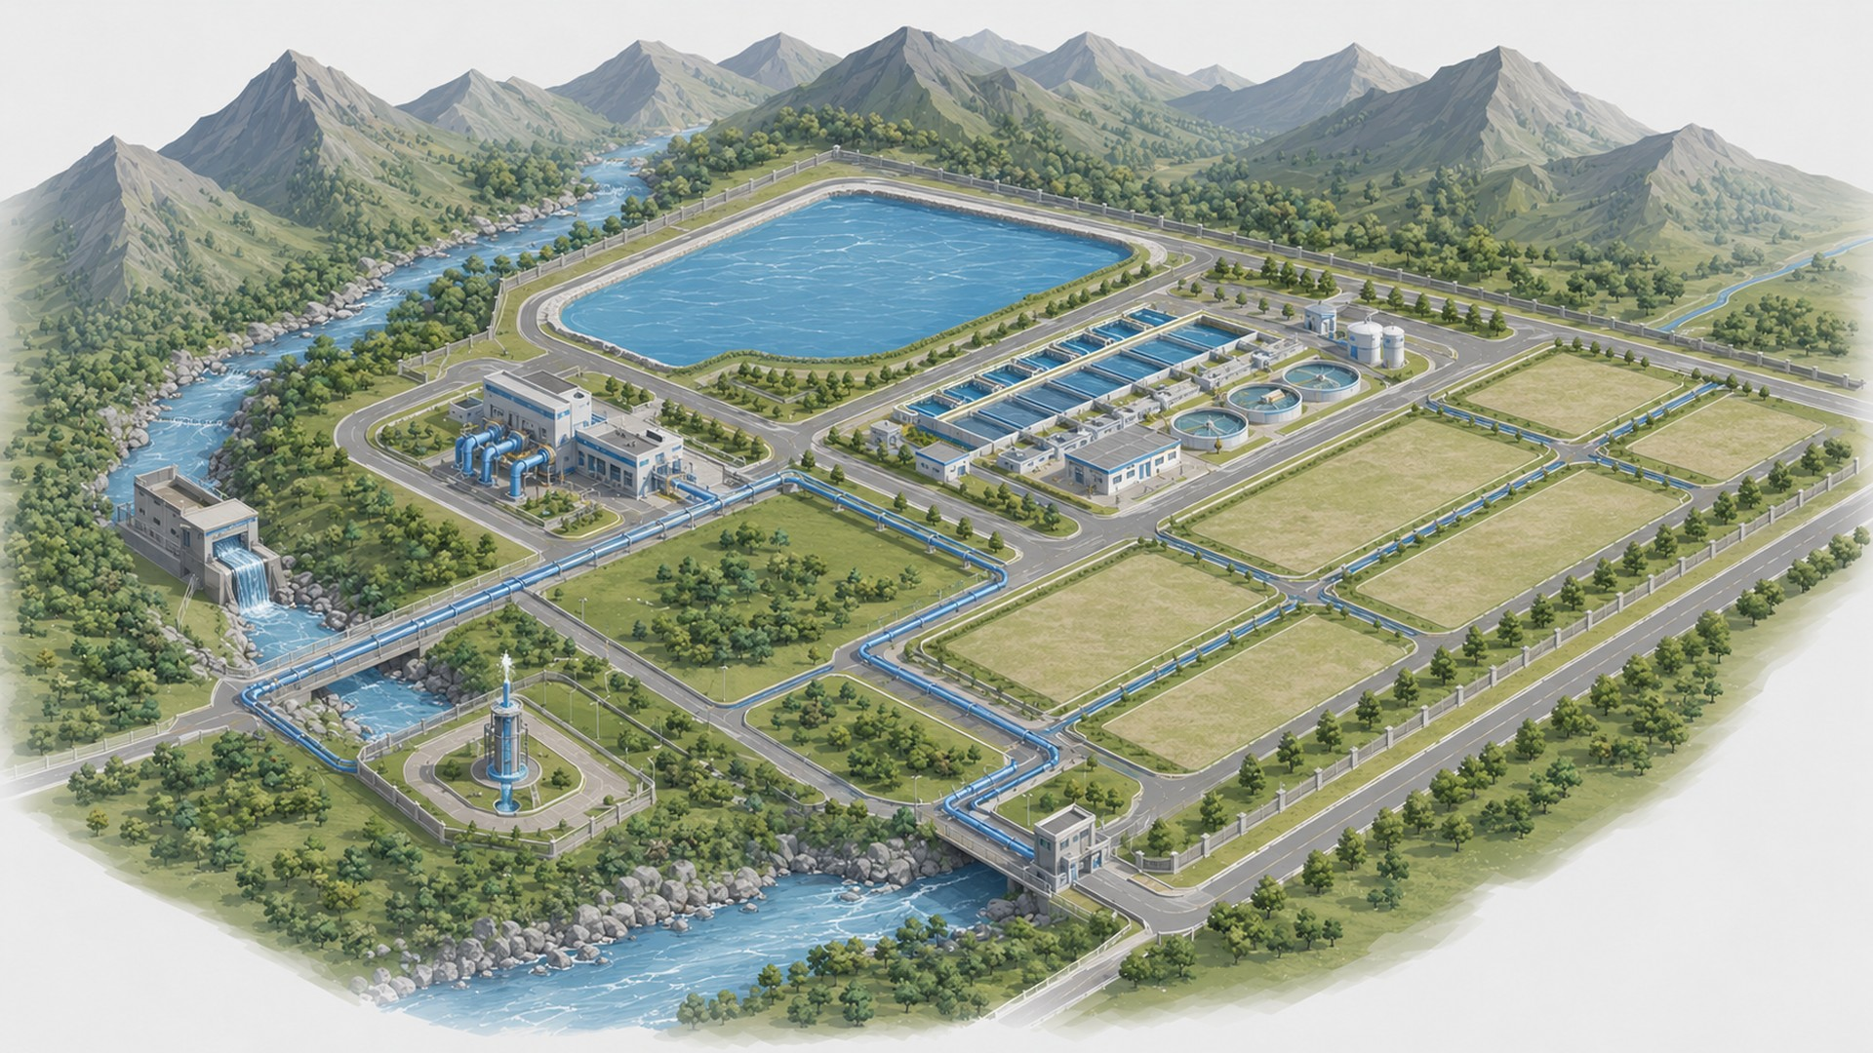
04.1
Water contour
First confirmable resource contour for site development
FUNCTION
water intake, well, reservoir, pumping station and distribution network
TASK
confirm the water base for construction, agro-operations and industry
EFFECT
first managed stage of territorial development and demand for pipes, pumps and service
JSC “TIC “TEMIRLAN-OIL” | FEZ “MAIMAK” | PROPOSED DEVELOPMENT MODEL
6

Slide 7
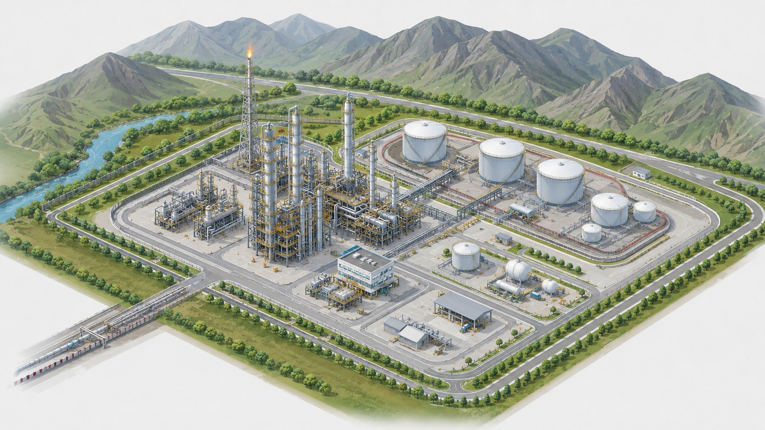
04.2
Refinery and storage tanks
Strategic industrial core of FEZ “Maimak”
FUNCTION
crude intake, tank farm, processing and product dispatch
TASK
connect crude supply, technology,
financing and sales markets
into a single project line
EFFECT
formation of a major regional-scale industrial hub
JSC “TIC “TEMIRLAN-OIL” | FEZ “MAIMAK” | PROPOSED DEVELOPMENT MODEL
7

Slide 8
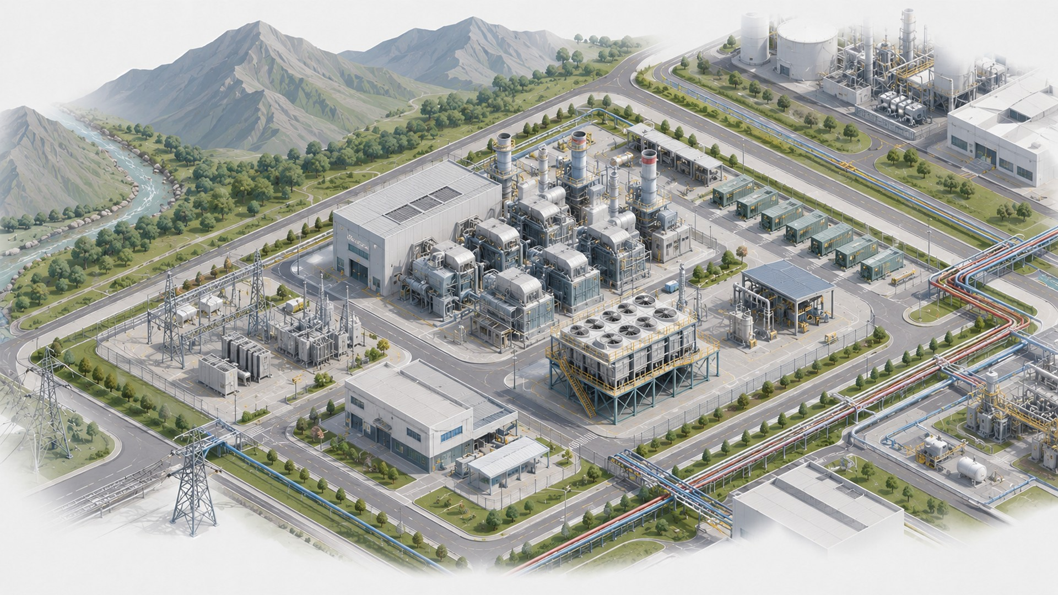
04.3
Energy module
Own energy base for the refinery, networks and residents
FUNCTION
generation, distribution networks, backup power and engineering nodes
TASK
supply the refinery, pumping stations, service facilities and future residents
EFFECT
reduced infrastructure risks and modular expansion potential for the site
JSC “TIC “TEMIRLAN-OIL” | FEZ “MAIMAK” | PROPOSED DEVELOPMENT MODEL
8

Slide 9
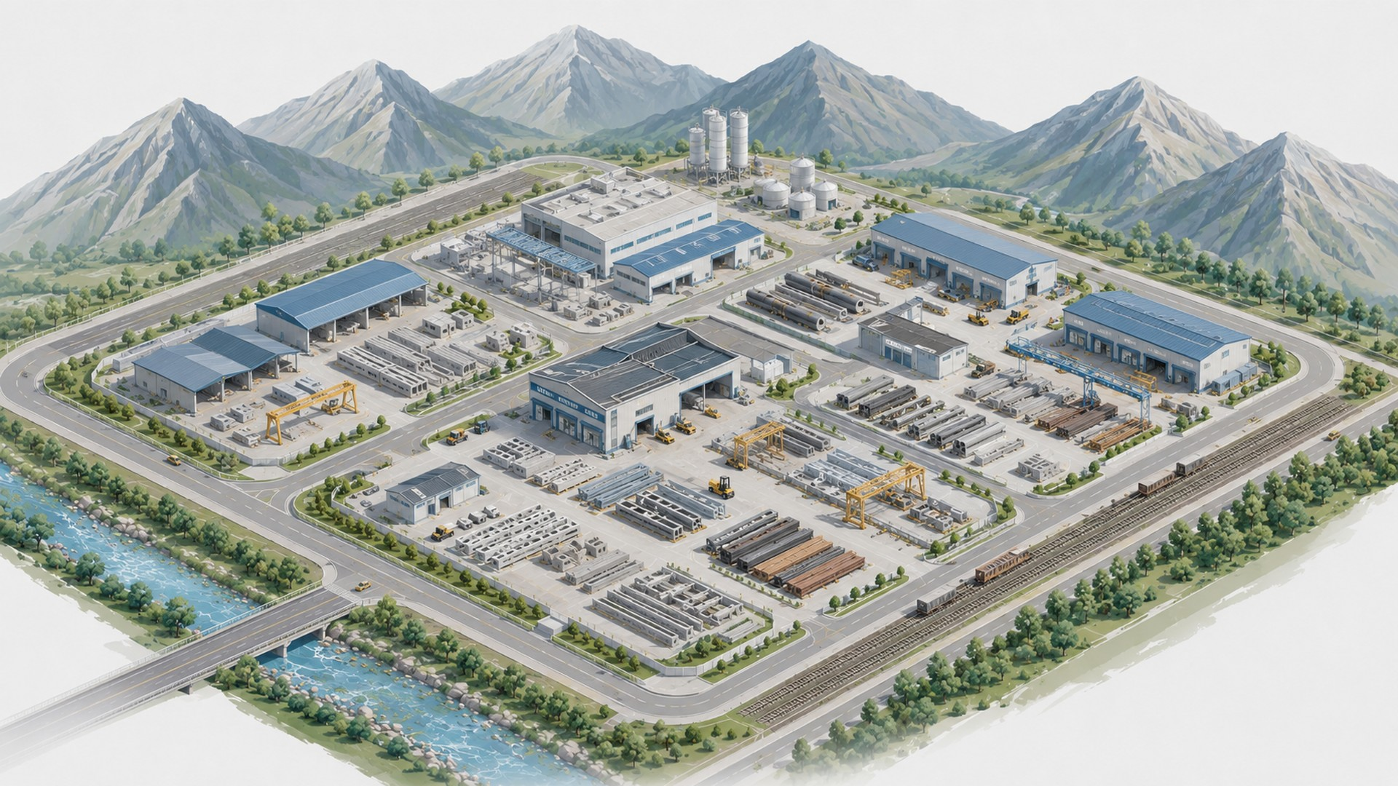
04.4
Base production
Local capacity for construction, repairs and the resident economy
FUNCTION
steel structures, precast concrete, pipes and repair-mechanical facilities
TASK
cover part of construction and subsequent operating needs on site
EFFECT
jobs, localization and first industrial residents
JSC “TIC “TEMIRLAN-OIL” | FEZ “MAIMAK” | PROPOSED DEVELOPMENT MODEL
9

Slide 10
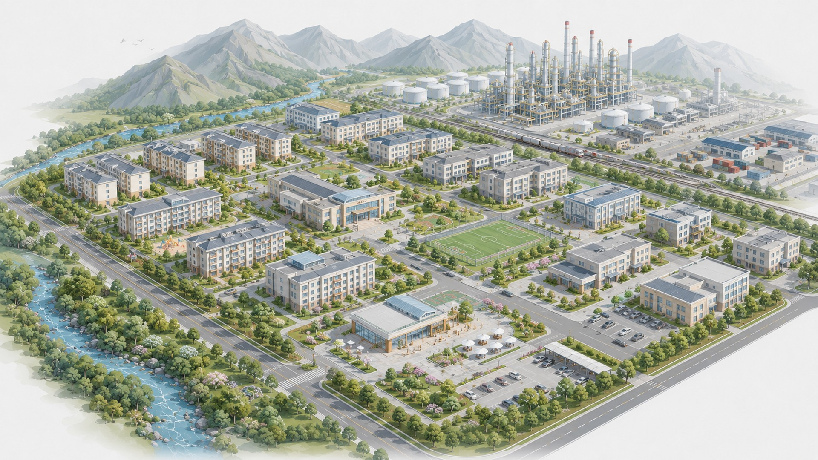
04.5
Workforce and social block
Infrastructure for stable employment and long-term operation
FUNCTION
housing, welfare infrastructure, medical station and administrative facilities
TASK
reduce dependence on rotational staffing and retain personnel in the region
EFFECT
workforce base, social stability and reduced operating risks
JSC “TIC “TEMIRLAN-OIL” | FEZ “MAIMAK” | PROPOSED DEVELOPMENT MODEL
10

Slide 11
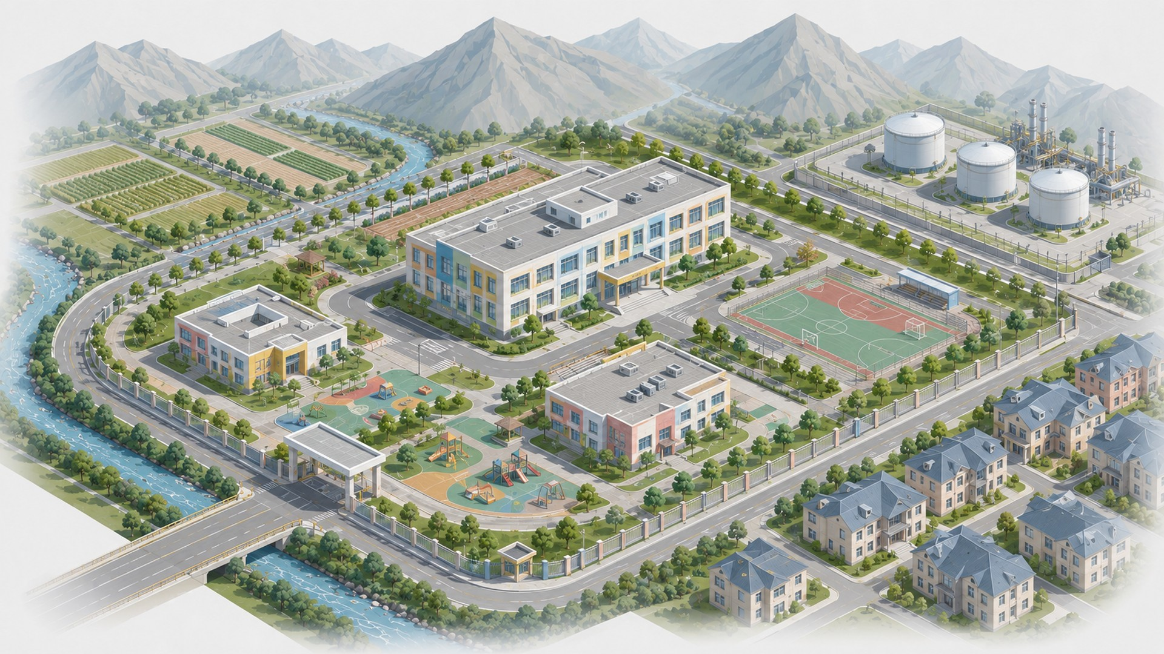
04.6
School and kindergartens
Social infrastructure for employees’ families and the local community
FUNCTION
education facilities, kindergartens, sports and public spaces
TASK
create conditions for permanent residence of specialists and their families
EFFECT
workforce retention, reduced population outflow and social environment development
JSC “TIC “TEMIRLAN-OIL” | FEZ “MAIMAK” | PROPOSED DEVELOPMENT MODEL
11

Slide 12
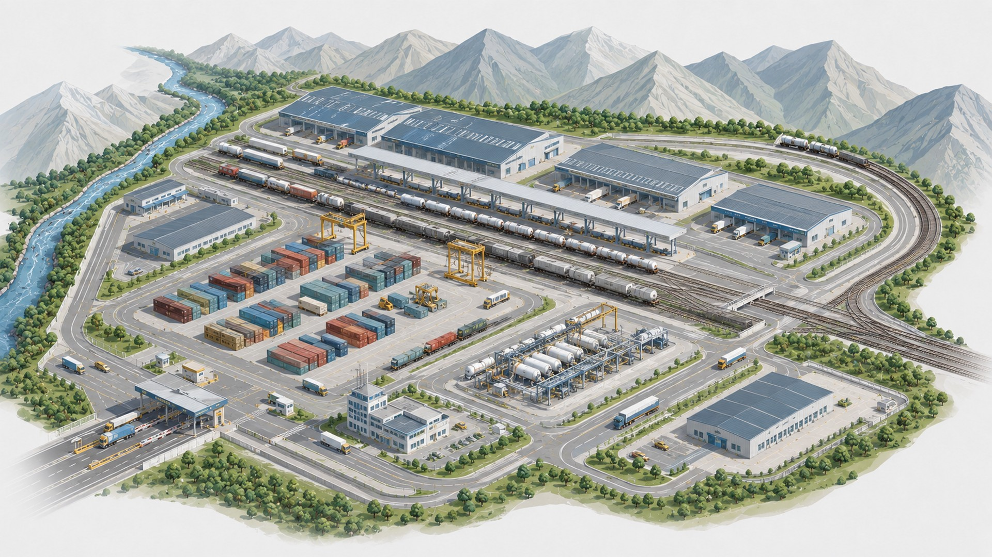
04.7
Rail and logistics
Transport framework for feedstock, equipment, products and residents
FUNCTION
intra-site tracks, warehouses, container area and loading/unloading nodes
TASK
connect crude supply, equipment, refinery products and resident flows
EFFECT
export-logistics role of the FEZ and lower cargo movement costs
JSC “TIC “TEMIRLAN-OIL” | FEZ “MAIMAK” | PROPOSED DEVELOPMENT MODEL
12

Slide 13
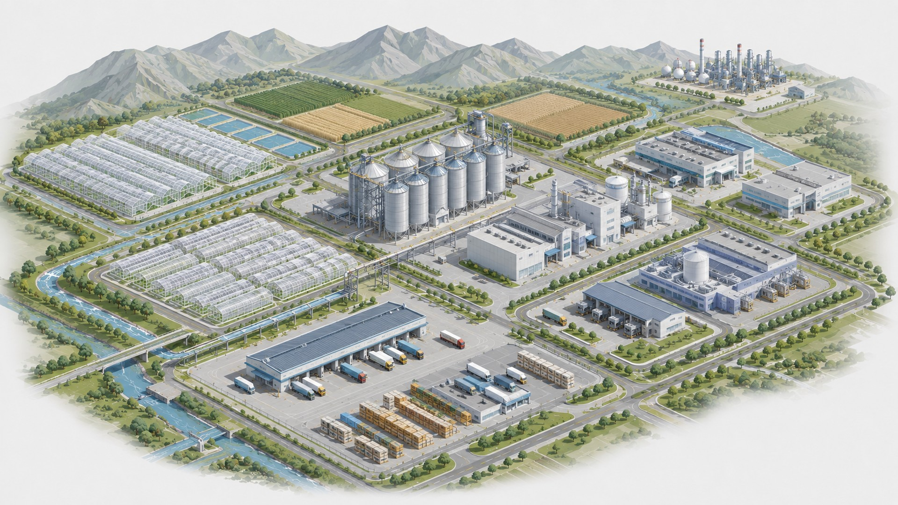
04.8
Agro and greenhouse block
Early economic line around water, storage and processing
FUNCTION
greenhouses, fields, grain elevator, flour mill, feed plant and carton-packaging plant
TASK
launch early operations and create users of water, energy and logistics
EFFECT
support for agro-processing, regional markets and early site economy
JSC “TIC “TEMIRLAN-OIL” | FEZ “MAIMAK” | PROPOSED DEVELOPMENT MODEL
13

Slide 14
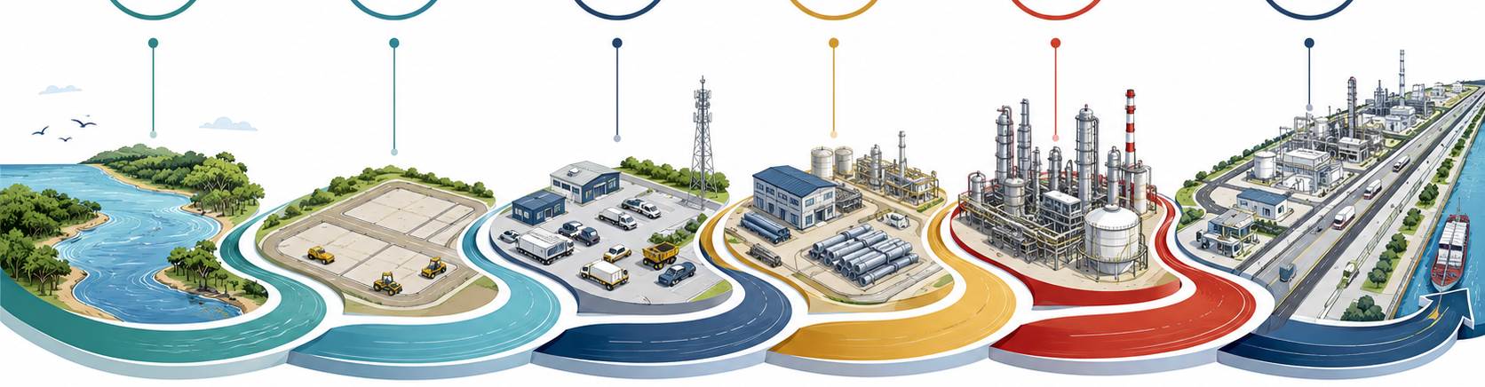
05
Development logic: parallel refinery preparation and phased territorial development
Refinery design proceeds in parallel with early territorial development; capital-intensive scale-up is allowed only after key conditions are confirmed
1
2
3
4
5
6
Water and
land
Service and
warehouses
Base
production
Engineering
platform
Refinery
launch
Industrial
corridor
Refinery track — parallel preparation
Territorial track — demand validation
master plan → feasibility study → design → crude and offtake → EPC / equipment → permits → investment decision
water → agro / storage → services → residents → engineering modules → site economy
Working logic: early contours activate the territory, but do not replace the refinery.

Slide 15
06
First contour: water, land and economic launch of the territory
The water contour is proposed as the first confirmable stage of practical site development
What must be confirmed
What water enables
Limitations
legal regime for water use
flow rate, quality and seasonality
cost of water lifting and distribution
first confirmed use case
absence of blocking restrictions
irrigation and pilot agro-operations
feed, storage and agricultural logistics
construction water contour
demand for pipes, pumps and maintenance
regional support for the project
build excess capacity without utilization
turn the agro block into a separate strategy
mix refinery financing with the water-agro pilot
promise impact before water and economics are verified
First 90-day outcome: confirmed water base, legal water-use scheme, pilot-project economics and list of potential partners

Slide 16
07
Early economic contour: validation of demand, logistics and operational readiness
The first-stage objective is to confirm demand, launch initial economic operations and prepare the territory for major construction
Trade and
logistics pilot
Service
base
Base
production
Modular
networks
Residents
and JVs
grain elevator, flour mill, feed production, storage, transshipment, commercial-model testing
workshops, spare parts, machinery, warehouse contour
steel structures, precast concrete, pipes, simple processing
power, water, wastewater, fire reserve, communications
partners, leases, joint ventures, localization
Main criterion: each contour must confirm real demand, repeatable operations and a positive contribution to preparing the FEZ for the refinery launch.

Slide 17
08
Refinery: strategic core and parallel project line
Early stages do not delay the refinery — they reduce construction risk and improve project quality
Principle: refinery design and preparation start from the first stage, while capital-intensive construction begins only after crude supply, market, financing and permitting pathway are confirmed.
Master plan
and concept
Crude supply and
pipeline
Design and
permits
Design, procurement and construction
Commissioning and
operation
general layout, feasibility study, logistics, input data
connection, supplies, storage tanks, supply route
design documentation, industrial and environmental safety, state expert review
contracting of designers, contract preparation, equipment supply and construction management
commissioning, personnel training, start-up and support
The refinery project roadmap remains the core engineering framework; the new FEZ model adds early site economics and risk management.

Slide 18
09
Organizational architecture: separation of roles and responsibilities
JSC “TIC “Temirlan-Oil” retains strategic control over the project, land contour and overall coordination
JSC “TIC “Temirlan-Oil”
strategic control, land, project coordination
Water contour
Agro / logistics
Engineering networks
Refinery project company
water intake, networks, connections, operation
storage, feed pilot, transshipment, warehouses
power, wastewater, firewater, communications
crude supply, EPC, financing, permits
Joint ventures / residents
localization, precast concrete, steel structures, packaging, fertilizers
Project management is proposed through clear allocation of responsibility, specialized project structures and joint ventures with partners.

Slide 19
10
Management discipline: each transition must be justified
Transition to the next stage is allowed only after technical, legal, economic and financial readiness is confirmed.
90 days
3–6 months
6–12 months
9–12 months
confirm the water and land contour
form the partnership and organizational structure
readiness for the infrastructure stage
readiness for a refinery investment decision
water-base conclusion
legal opinion
pilot-project economics
partner map
control decision to proceed
at least two anchor partners
network requirements
project-company and JV model
initial economics
investor package
module utilization
CAPEX estimate for engineering infrastructure
source of financing
technical configuration
responsible operator
crude supply
offtake
capital structure
permitting pathway
readiness for design, procurement and construction
CONTROL DECISION
CONTROL DECISION
CONTROL DECISION
CONTROL DECISION

Slide 20
11
Roadmap: what should happen in the next 24 months
Focus on practical decisions, documents and interagency coordination
0–90 days
Water, land, legal basis, pilot economics
confirmation of initial conditions for the first stage
3–6 months
Partners, project companies, list of first residents, master plan
managed project architecture
6–12 months
Modular infrastructure, feasibility study, design, financing applications
readiness to create engineering infrastructure
12–24 months
Contractual preparation of design, procurement and construction; crude supply and offtake; state expert review; anchor residents
preparation for the refinery investment decision
State support is needed not instead of investment, but to reduce institutional risks: FEZ status, interagency coordination, infrastructure conditions and support for the pipeline and cross-border track.

Slide 21
12
Expected impact for the Kyrgyz Republic
FEZ “Maimak” can become not merely a local facility, but an industrial growth point for western Kyrgyzstan
Employment and skills
Industrial base
Logistics and export
job creation, training of local specialists, reduced population outflow
refinery, engineering infrastructure, steel structures, precast concrete, services
railway, road transport, pipeline, access to regional markets
Regional development
Investment and taxes
Project controllability
water, agro, greenhouses, processing, strengthening Talas Region
private capital attraction, asset value growth, tax base after launch
phased decisions, evidence base, project companies, risk control
It is proposed to support the development of a master plan for the comprehensive development of FEZ “Maimak”, establish an interagency working group and define a unified state coordination mechanism for the project.
FEZ “Maimak”: the refinery as the industrial core, early contours as a risk-reduction tool, and state coordination as a condition for timely project implementation and investment attraction.
Materials prepared by JSC “TIC “Temirlan-Oil” based on project documentation and preliminary project development results.

